Slide 1
CHARACTERISTICS OF IC’s: VOLTAGE & CURRENT PARAMETER , NOISE IMMUNITY
NAME | ROLL NO | PRN NO
ANUSHKA BHAGWAT | 224001 | 22110043
ARYAN PANDITA | 224004 | 22110146
YASHRAJ AWARE | 224006 | 22110167
KAUSTUBH BHOSKAR | 224007 | 22110970
Under the guidance of : Prof. Yogesh Sharma

Slide 2
INTRODUCTION:
A group of compatible ICs with same logic levels and Supply Voltages fabricated for performing Various logical functions refered as a logic family.
Logic gates are available in the form of integrated circuits(IC’s)
As per the level of integration, the IC’s can accommodate more number of logic gates and digital functions.
These forms are referred as logic family.

Slide 3
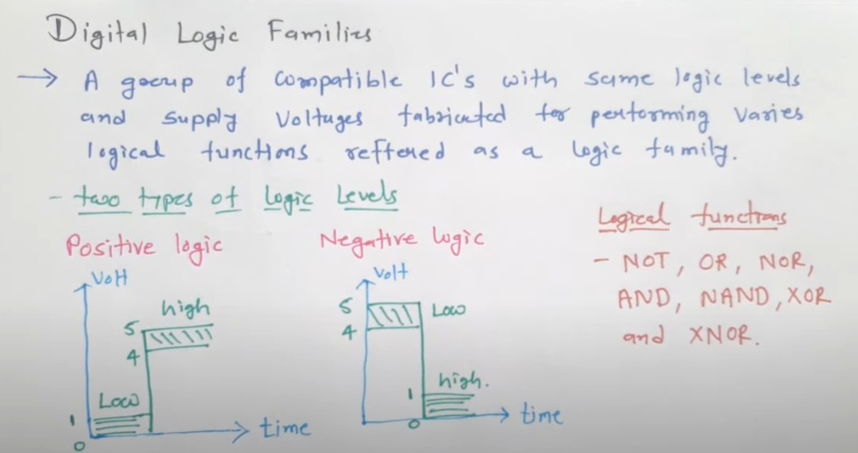

Slide 4
Digital Logic Families
Bipolar Logic Families
[ It uses electrons & holes as Charge carriers. ]
-[ Resistor, transistor & Diodes ]
Unipolar Logic Families
[ H uses One type Charge Carrier electrons or holes. ]
-[MOS]
-PMOS,NMOS,CMOS
Saturated
[device will be ON (saturated region) or OFF(cutoff region)]
Ex. RTL,DTL,DCTL,IIL,HTL,TTL
Non-Saturated
[ devices will be used in active region. ]
Ex. Schott Key TTL, ECL.

Slide 5
CHARACTERISTICS:
As per the level of integration, the IC’s can accommodate more number of logic gates and digital functions
The following are the characteristics of the Digital IC’s:
Speed of operation
Power Dissipation
Figure of Merit
Fanout
Current and Voltage parameters
Noise immunity
Operating Temperature range
Flexibility Available

Slide 6
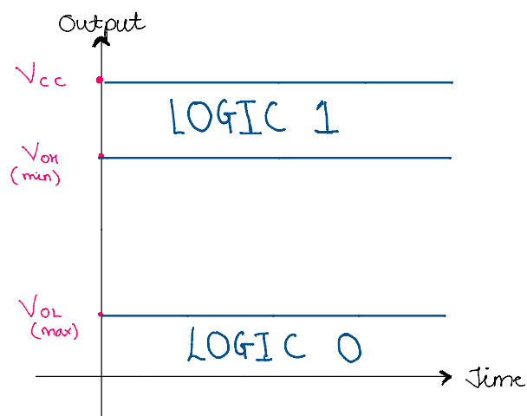
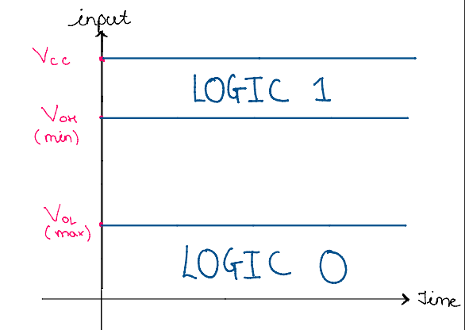
VOLTAGE PARAMETERS
OUTPUT VOL. v/s TIME INPUT VOL. v/s TIME
Where,
V(oh): min o/p voltage for logic 1
V(ol): max o/p voltage for logic 0
Where,
V(ih): min o/p voltage for logic 1
V(il): max o/p voltage for logic 0

Slide 7
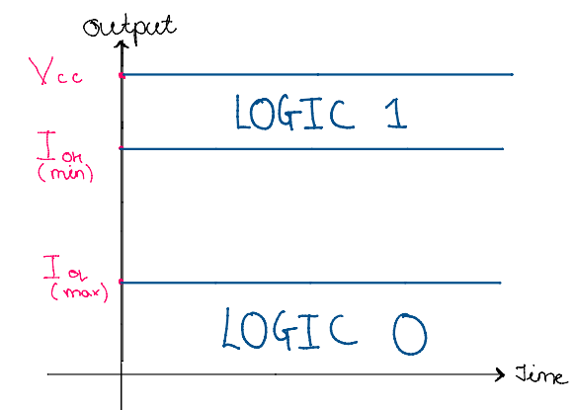
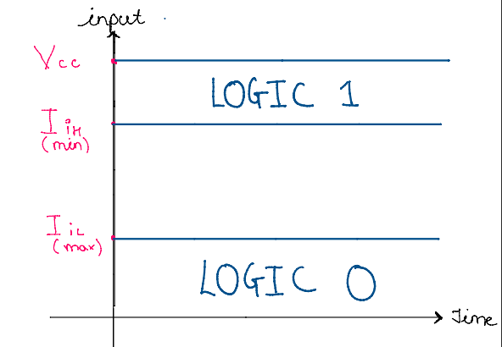
CURRENT PARAMETERS
OUTPUT CURRENT. v/s TIME INPUT CURRENT. v/s TIME
Where,
I(oh): high level output current
I(ol): low level output current
Where,
I(oh): high level input current
I(ol): low level input current

Slide 8
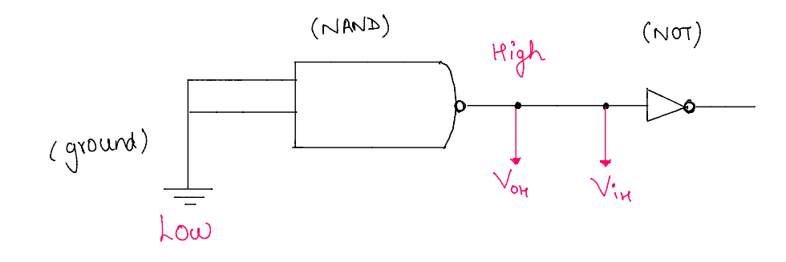
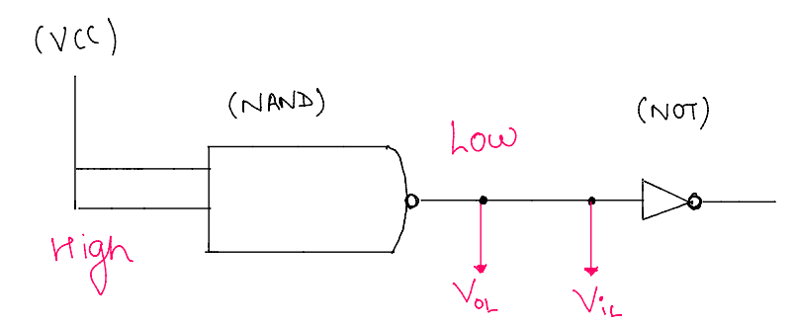
EXAMPLE:
When the input is Low
When the input is High

Slide 9
BASIC OF NOISE MARGIN
It explains, up to what extent, Ic allows noise in the transmission of logic ‘0’ and logic ‘1’.
In digital Integrated circuits, we don’t receive only two voltages(one for logic ‘0’ and another for logic ‘1’.
Here we receive a range of voltages and we identify logic ‘0’ or ‘1’ based on it.
Received voltage range widens based on noise in the circuit so, for errorless transmission, a noise margin is required.
Noise immunity is the maximum noise that can be tolerated by the circuit

Slide 10
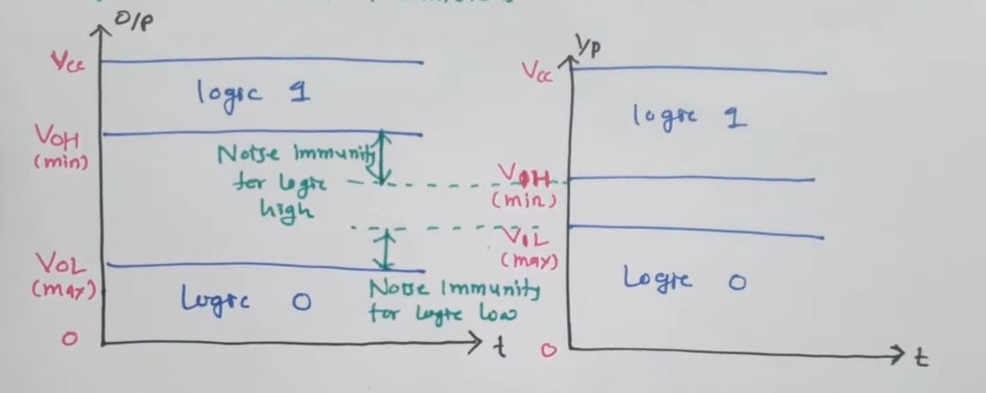
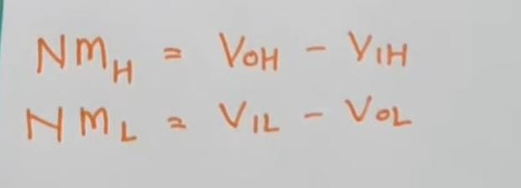
EQUATION OF NOISE MARGIN
We can see the logic 1 range at input is bit greater than logic 1 range at output side
And logic 0 range at input side is greater than logic – at output

Slide 11
THANK YOU!

